Slide 1


Optimizing the cement manufacturing process

Slide 2

Project Leadership
Sharat Manikonda
Director at Innodatatics and Sponsor
linkedin.com/in/sharat-chandra

Slide 3
Team Members
Name: M. Satish Kumar
https://www.linkedin.com/in/m-satish-kumar-427023226

Slide 4

Contents
Business objective
Business Constraints
Project Architecture
Data collection and details
Exploratory Data Analysis
Visualization
Modeling
Evaluation
Deployment
Notes:
Change

Slide 5
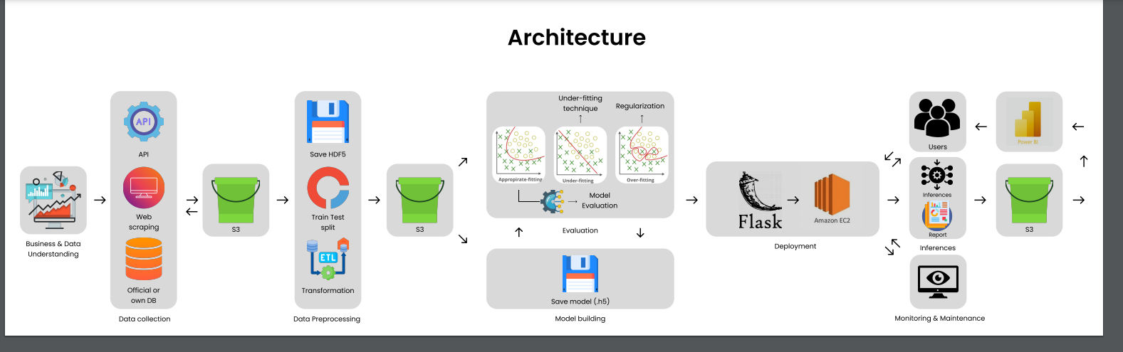
Project Overview and Scope

Slide 6

Business Problem
Inspecting cement quality manually once per hour has drawbacks. If an issue arises betweeninspections, we cannot rectify it and must discard the cement produced during that period. Stopping production, inspecting machine components, and addressing any issues before resuming manufacturing leads to wasted raw materials, increased machine downtime, and loss of revenue. Moreover, there is a risk of not meeting the demand.

Slide 7

Business Objective
Objective
Constraints
Minimize inspecting cycle time & Minimize raw materials wastage
Minimize the manual effort.

Slide 8
There are six stages of CRISP-ML(Q) Methodology:
1. Business and data understanding
2. Data preparation
3. model building
4. Model evaluation
5. Model deployment
6. Monitoring and maintenance
CRISP-ML(Q) Methodology

Slide 9








Technical Stacks
Language :
IDE :
Libraries :
Web-Frame :

Slide 10

Data Collection and Understanding
The data which we've collected is directly from the client. This dataset is related to TMT steel industry. which is dealing with the production and distribution of steel products, navigates the market with a diverse range of diameters, grades, and lengths.
We've got the data in CSV format, consisting of 12 columns with 33045 rows. The columns are related to various aspects of the TMT steel production and distribution process, such as product specifications, quantities, rates, and values, which are crucial for analysis and decision-making.
The data will be applied for forecasting objectives, involving the training and validation of a predictive model through the utilization of machine learning techniques. This approach aims to facilitate accurate predictions and well-informed decisions.

Slide 11
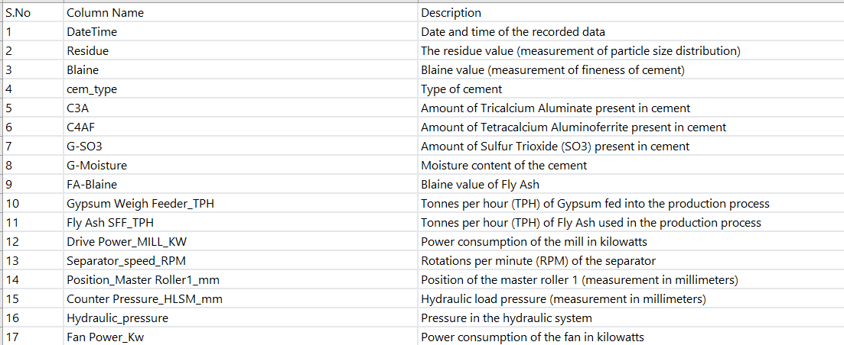
Data Dictionary

Slide 12

System Requirements
General prerequisites
Numerical & Categorical data.
Installing required libraries in the system.
For the fastest performance run it on GPU
System Requirements
Memory: 8GB
Graphics Card: NVIDIA GeForce 940MX / AMD Radeon RX 480
CPU: Intel Core i5
OS: Windows 8.1

Slide 13

Exploratory Data Analysis [EDA]
Exploratory Data Analysis (EDA) is a foundational technique for understanding data sets. By unveiling patterns and relationships, EDA sets the stage for further analysis. It encompasses visualization, stats, and data cleaning to transform raw data into insights. EDA is iterative, refining understanding as it progresses.
EDA employs visualization tools like histograms and scatter plots to reveal data distributions and outliers. Statistical analysis offers quantitative insights into central tendencies and variabilities. Data cleaning ensures accuracy by addressing inconsistencies and anomalies. As patterns emerge, EDA refines data exploration and guides subsequent analysis.
Notes:
EDA is used for seeing what the data can tell us before the modeling task.
Change

Slide 14
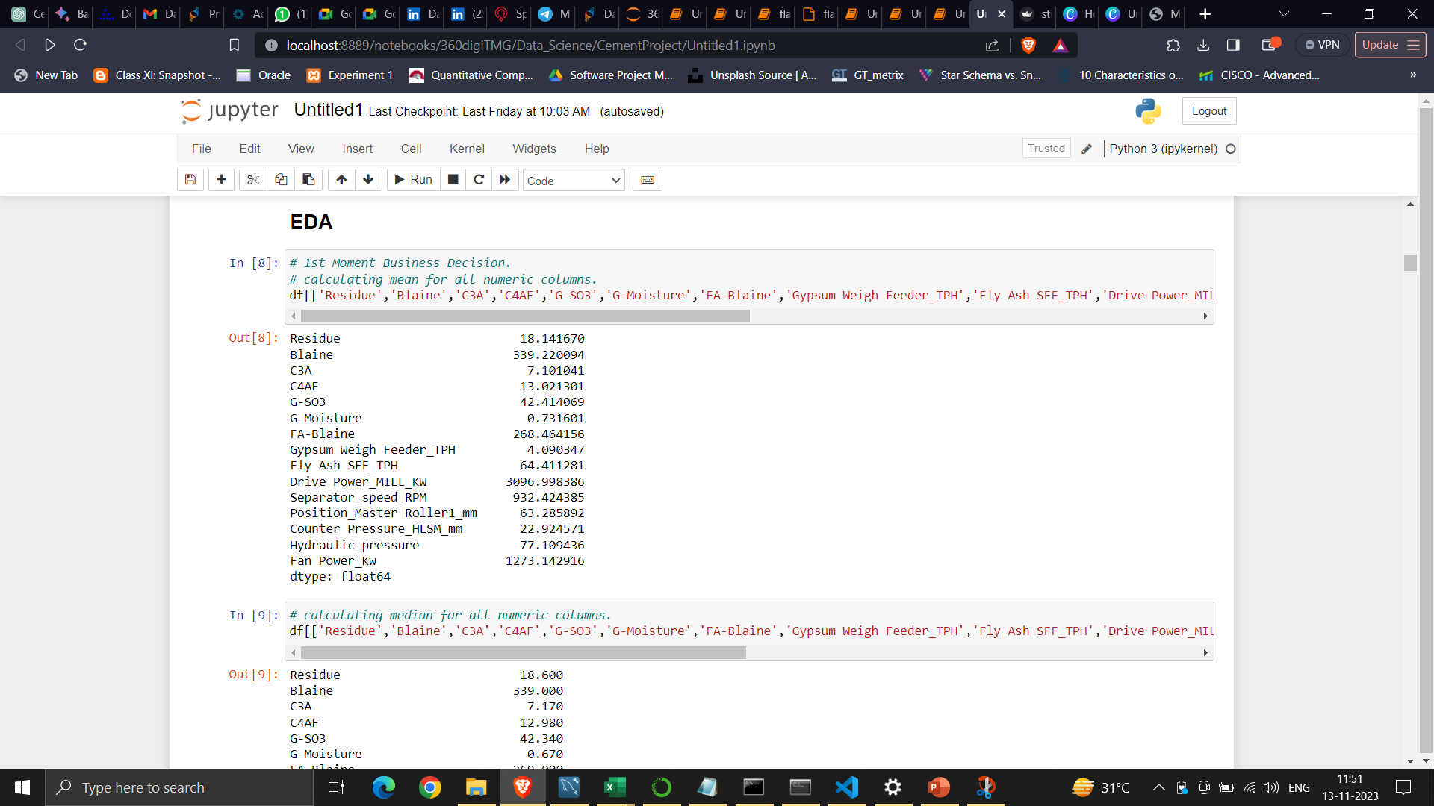
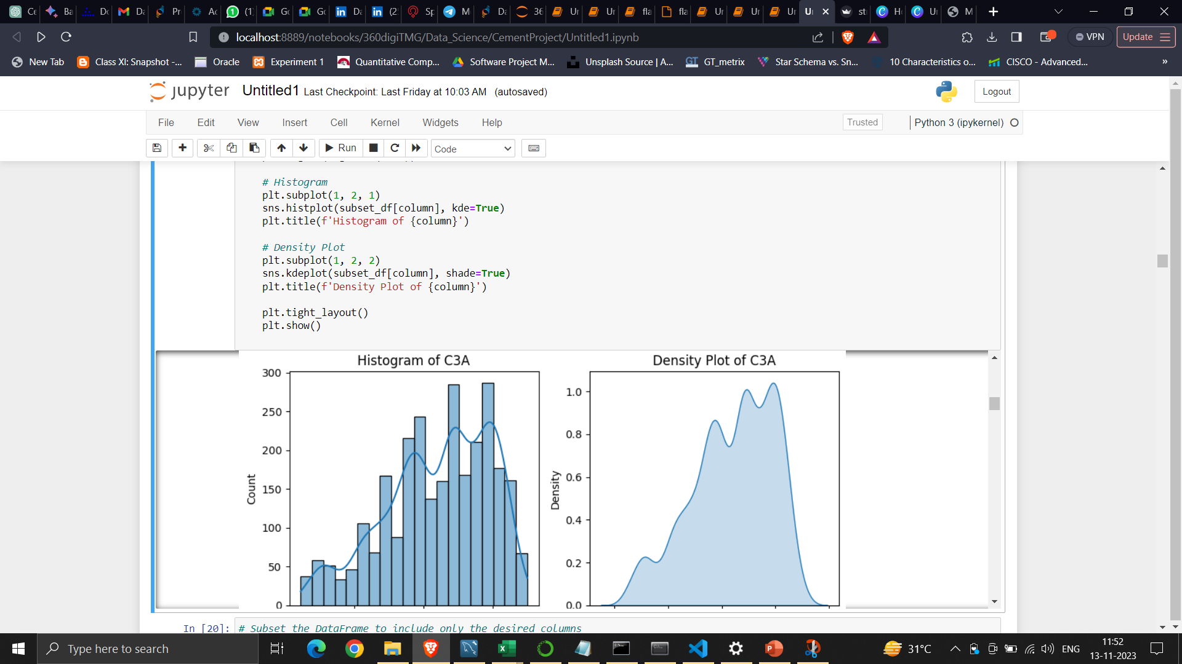
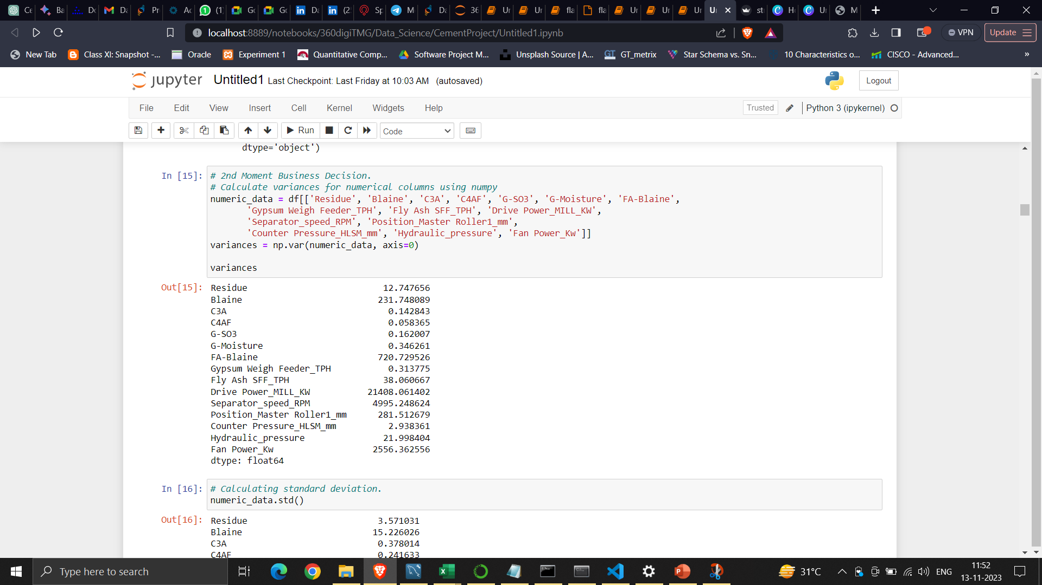
Exploratory Data Analysis [EDA]
During the EDA phase, we will engage in several processes. We will systematically address all four key business moments, accompanied by graphical illustrations.

Slide 15

Data Preprocessing
In the presence of missing values, the strategy entails applying pertinent techniques to handle them. Numerical values are addressed through Mean and Median Simple Imputer, while categorical data is treated using the Mode Imputer. Alongside, any duplicated entries are excluded from the dataset during the preprocessing phase.
In our dataset, we found 0 duplicates.
Missing values were found in our dataset.
Next, the dataset undergoes outlier treatment when outliers are identified. The application of Winsorization with diverse capping methods further contributes to addressing these anomalies.
Notes:
Keep observations

Slide 16
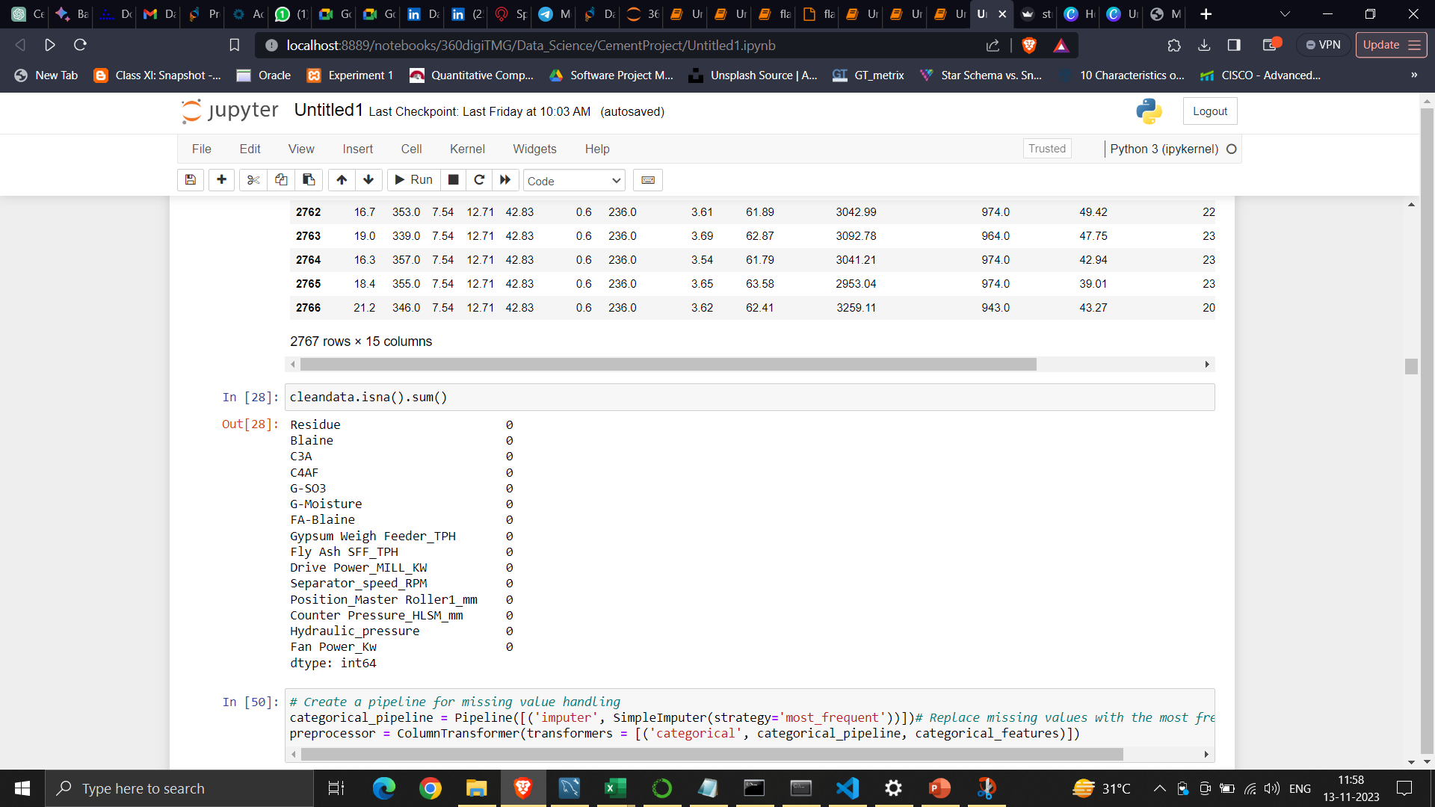
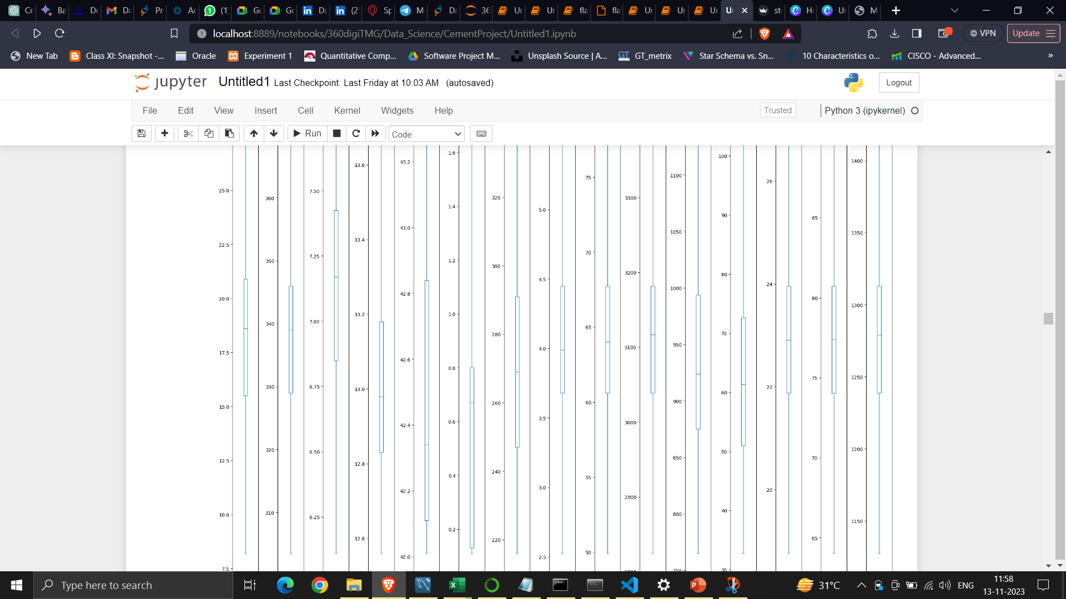
Result of Data Preprocessing
Checking missing values
Outlier Treatment

Slide 17
Data Visualization
Graphical Representation
Visualizing our dataset is one of the best ways to understand trend in our dataset, especially when we are dealing with large datasets.
Matplotlib and Seaborn are popular python libraries that can be used to create our data visualizations easily.
Visualizing our dataset helps us in understanding the trend, patterns and outliers within large dataset, it also helps in us to identify the correlations or the relationship between the independent variables.
For Better visualizations, I have used PowerBI. Hence following are the representations, with some of the important insights
Notes:
Add graphical

Slide 18
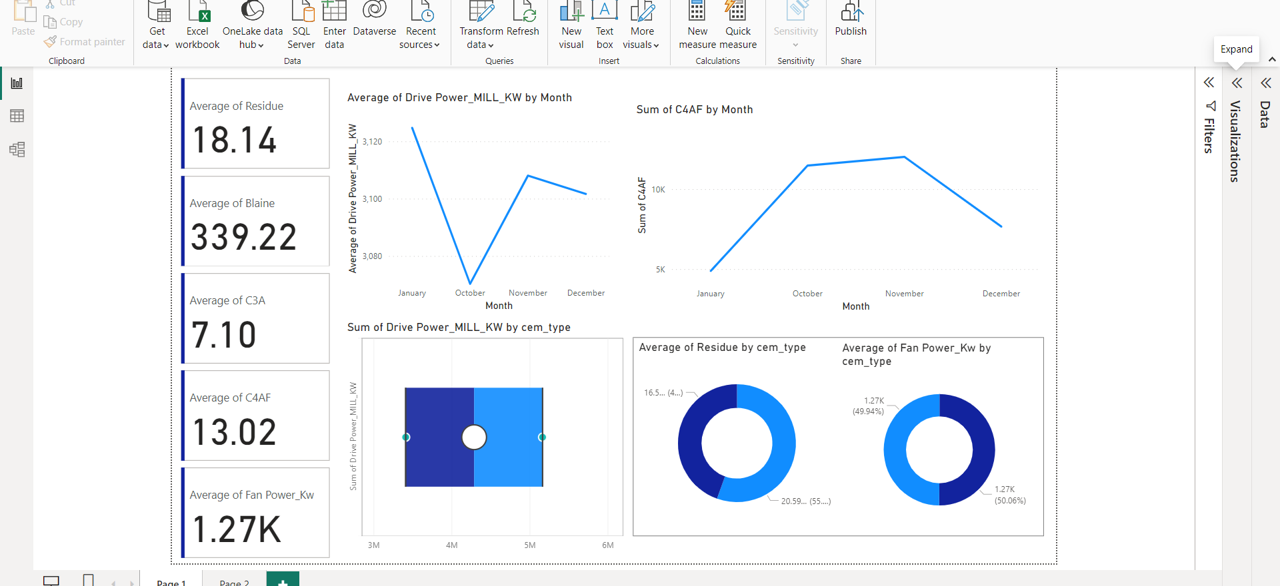
Data Visualization

Slide 19
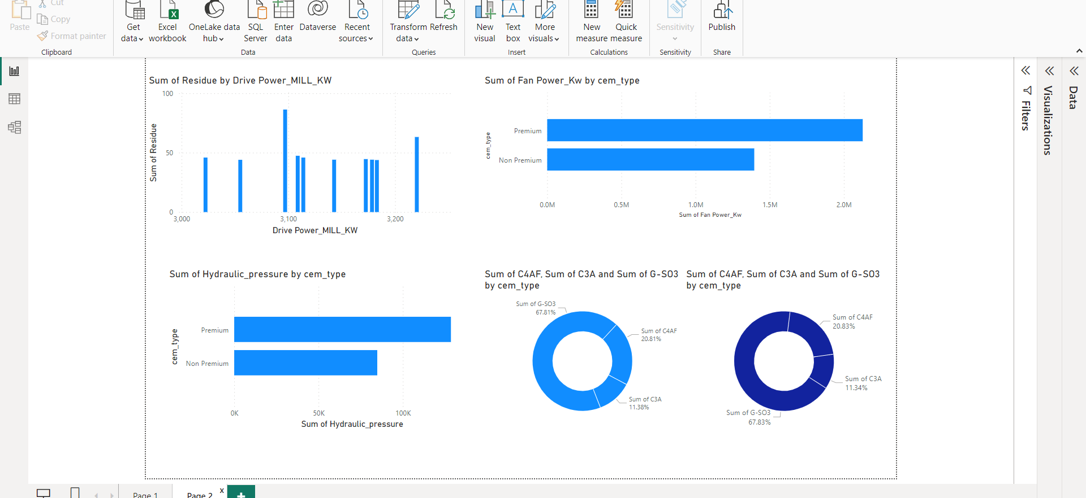
Data Visualization

Slide 20
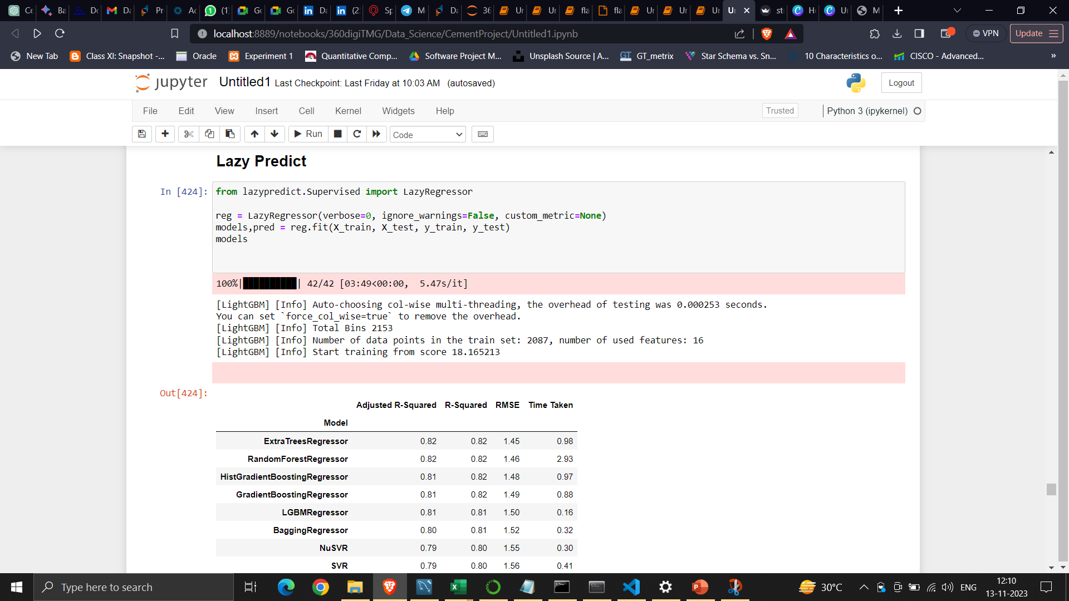
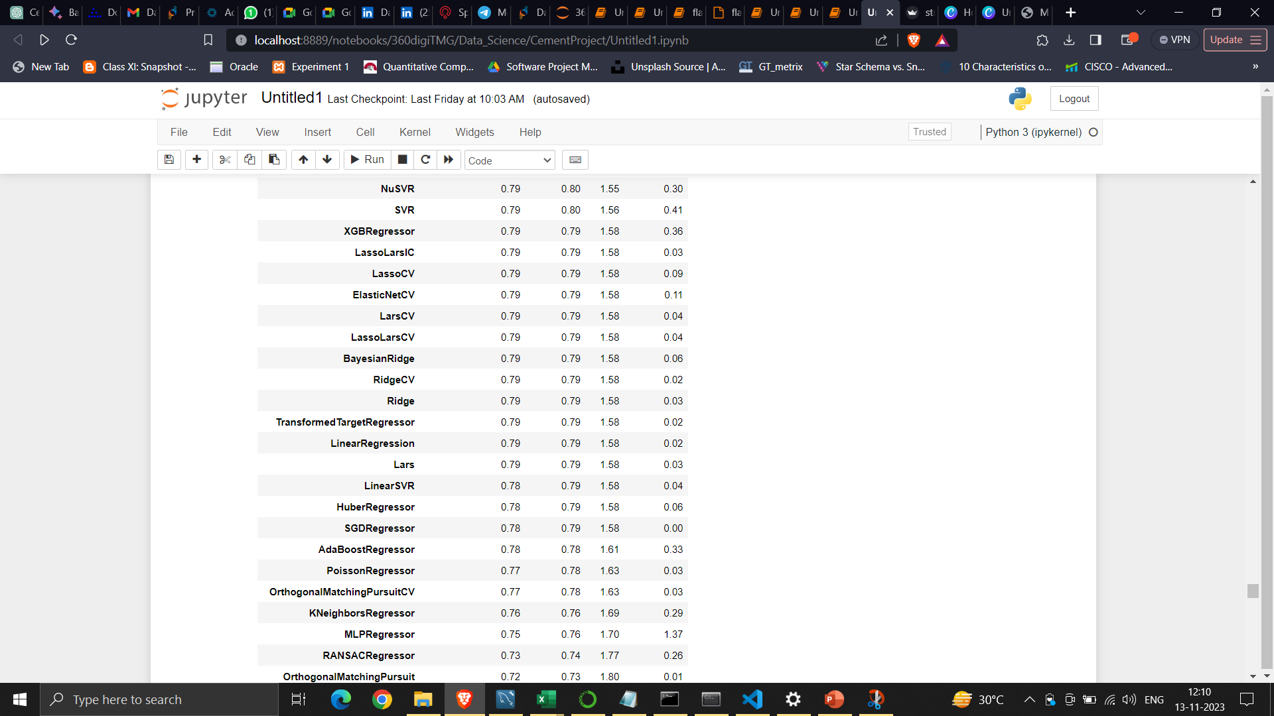
Model Building
LazyPredict
Lazy predict simplifies the process of model selection and evaluation, making it easier to kickstart your machine learning projects and get a quick sense of which models are worth further exploration. It's a time-efficient and beginner-friendly tool that can help you make informed decisions about your data analysis and modeling approach.
Notes:
classification is the task of predicting a discrete class label. Regression is the task of predicting a continuous quantity.
What is classification techniques in machine learning?
The Classification algorithm is a Supervised Learning technique that is used to identify the category of new observations on the basis of training data. In Classification, a program learns from the given dataset or observations and then classifies new observation into several classes or groups.
What is regression techniques in machine learning?
Regression is a technique for investigating the relationship between independent variables or features and a dependent variable or outcome. It's used as a method for predictive modeling in machine learning, in which an algorithm is used to predict continuous outcomes.

Slide 21
Accuracies for all models
Models-Builded | MAPE Value
Linear Regression | 7.39%
Decision Tree Regression | 6.8%
ExtraTreesRegressor | 6.64%
RandomForestRegressor | 6.73%
HistGradientBoostingRegressor | 6.81%
GradientBoostingRegressor | 6.87%
BaggingRegressor | 6.91%
LGBMRegressor | 6.89%
Notes:
Why Random Forest Regression is good?
A Random Forest Regression model is powerful and accurate. It usually performs great on many problems, including features with non-linear relationships
How is XGBoost different from random forest?
One of the most important differences between XG Boost and Random forest is that the XGBoost always gives more importance to functional space when reducing the cost of a model while Random Forest tries to give more preferences to hyperparameters to optimize the model..
n_estimators — the number of decision trees you will be running in the model

Slide 22
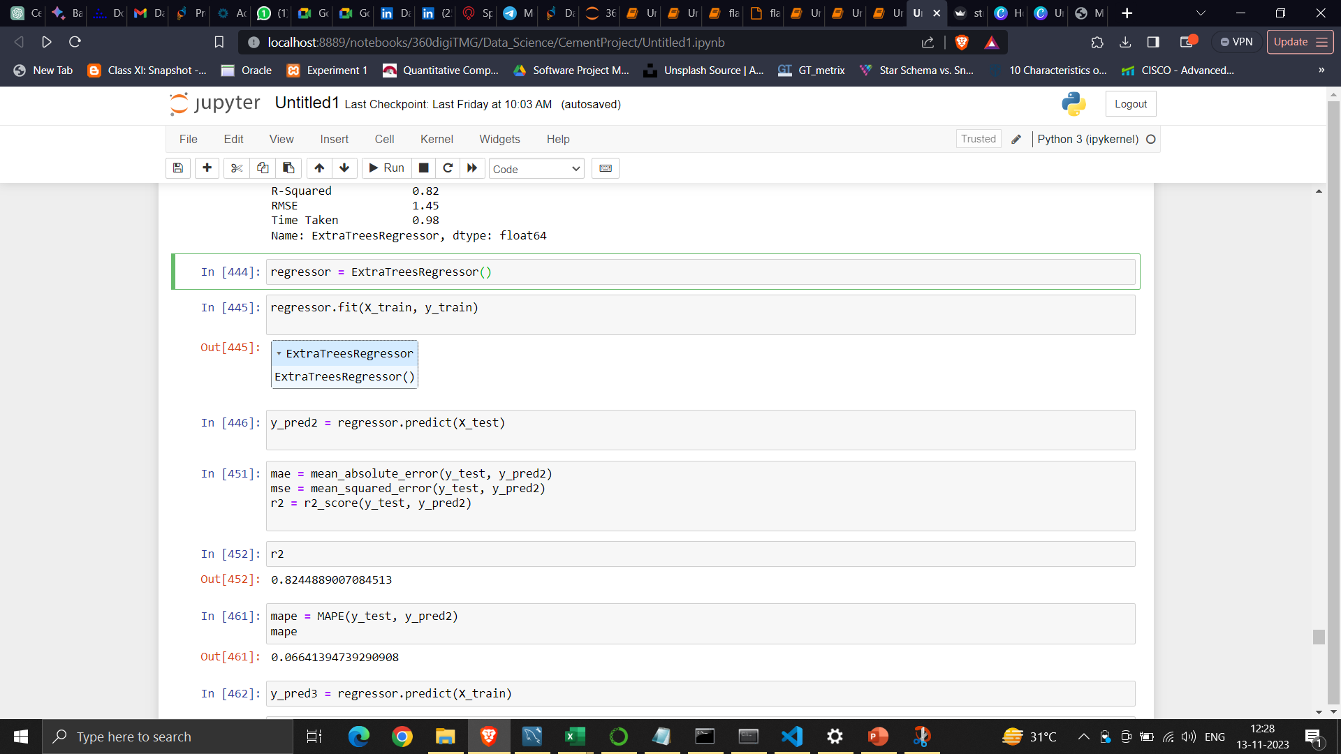
Best Model
In this project I'm choosing ExtraTreesRegressor as the Best model with test MAPE of 6.64%

Slide 23
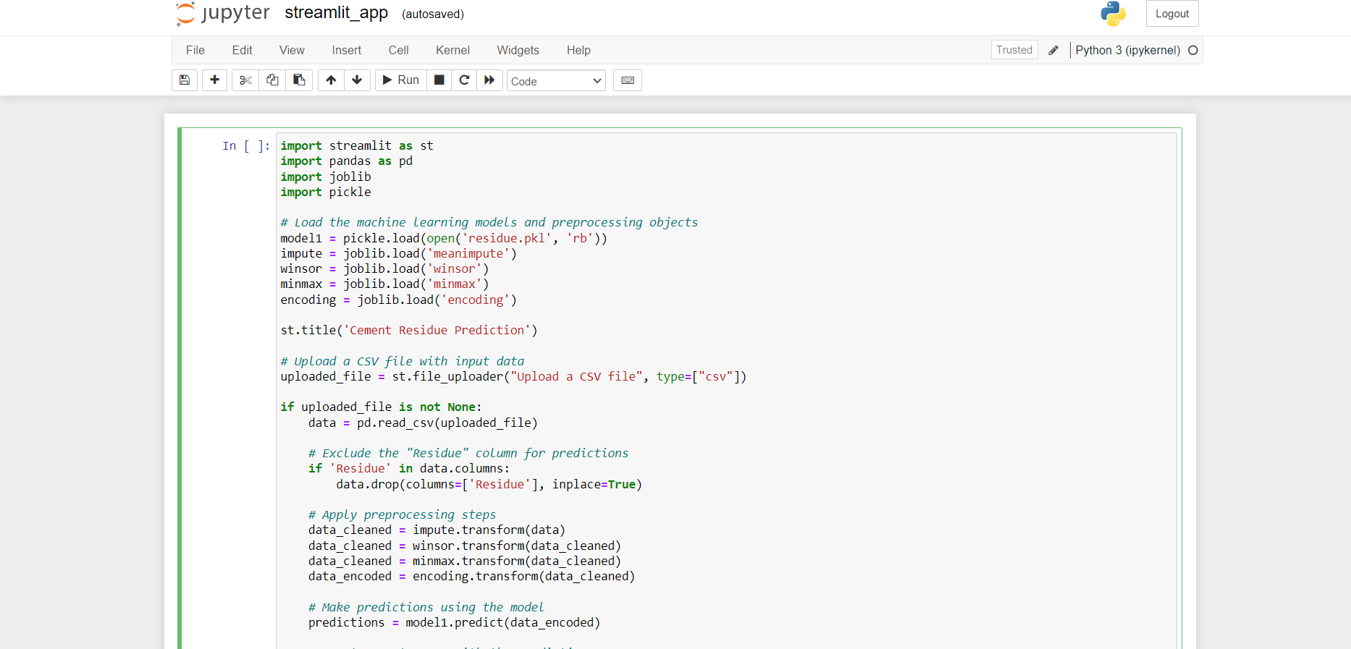
Model Deployment Strategy using Stream-Lit

Slide 24
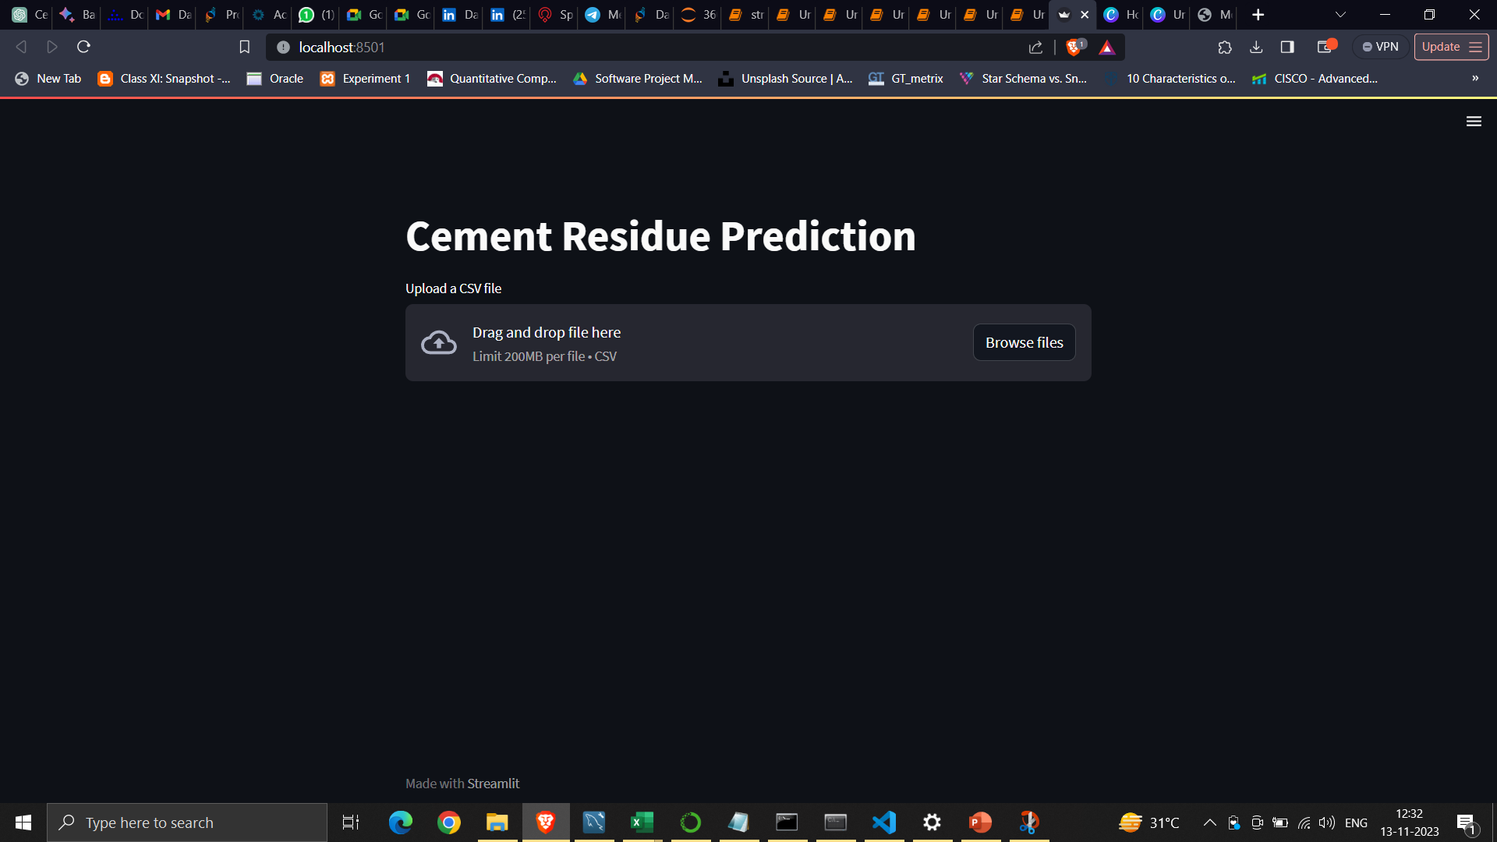
Screen shot of output

Slide 25
Challenges
Data Availability and Quality.
Data Pre-processing.
Ethical and Legal Considerations.
Seasonal and Cyclical Patterns.
Model Complexity.

Slide 26
Future Scopes
Advanced Modeling Techniques: Exploration of more sophisticated machine learning and deep learning models that can capture intricate demand patterns and relationships within the steel industry.
Predictive Analytics Tools: Creation of user-friendly tools that allow industry professionals to generate accurate steel rod quantity forecasts without in-depth technical expertise.
Risk Assessment: Incorporating risk assessment and uncertainty quantification into forecasting models to provide a more holistic view of potential outcomes.

Slide 27
Future Scopes
AI-driven Decision Support: Development of AI-powered decision support systems that help in making informed choices based on predicting cement qualities.
Continuous Learning Models: Building models that can adapt and self-improve over time as new data becomes available, leading to continuously enhanced accuracy.
Ethical AI Considerations: Addressing ethical concerns related to data privacy, bias, and fairness as AI-driven forecasting becomes more pervasive.
Industry Collaboration: Encouraging collaboration between academia, research institutions, and the cement industry to develop tailored forecasting solutions.

Slide 28

Queries ?

Slide 29


